Slide 1
GENERATIVE AI
WEEK-4
Asst.Prof.Dr.Murat ŞİMŞEK

Slide 2
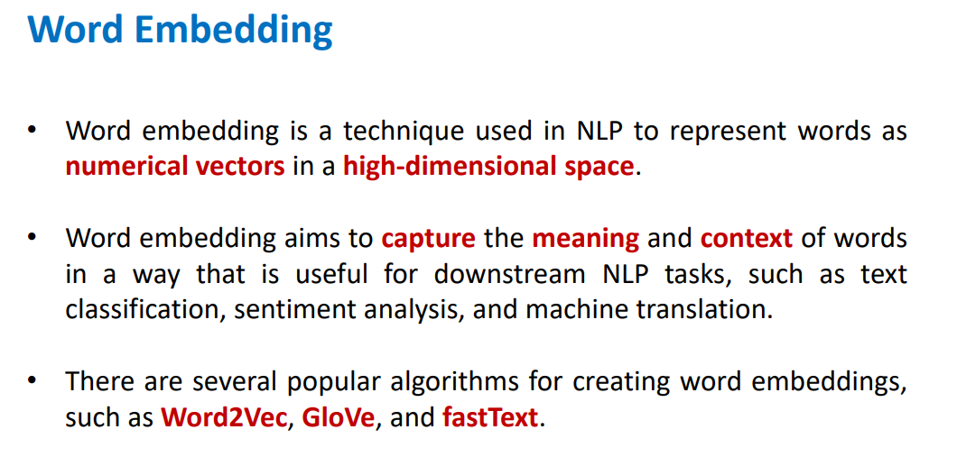
NLP
Notes:
**English Presentation Script:**
---
**Word Embedding in NLP**
**What is Word Embedding?**
Word embedding is a technique that represents words as **numerical vectors** in a high-dimensional space. Unlike traditional methods (e.g., one-hot encoding), these vectors capture semantic relationships and contextual meanings between words.
**Why Use Word Embedding?**
- **Semantic Similarity**: Words with similar meanings (e.g., "happy" and "joyful") have similar vector representations.
- **Context Awareness**: Captures relationships like analogies (e.g., *king - man + woman = queen*).
- **Efficiency**: Reduces dimensionality compared to sparse representations (e.g., TF-IDF).
**Applications**
- Text classification
- Sentiment analysis
- Machine translation
- Named entity recognition
**Popular Algorithms**
1. **Word2Vec**: Uses neural networks to learn embeddings (CBOW or Skip-Gram architectures).
2. **GloVe**: Combines global co-occurrence statistics with local context.
3. **fastText**: Represents words as subword units (handles rare/unseen words).
**Example**:
In a trained embedding space:
- `vector("king") - vector("man") + vector("woman") ≈ vector("queen")`
**Benefits**:
- Enables machines to "understand" language nuances.
- Improves performance in NLP tasks by preserving semantic relationships.
---
**Türkçe Sunum Metni:**
---
**NLP'de Kelime Gömme (Word Embedding)**
**Kelime Gömme Nedir?**
Kelime gömme, kelimelerin yüksek boyutlu bir uzayda **sayısal vektörler** olarak temsil edilmesidir. Geleneksel yöntemlerden (örn., one-hot encoding) farklı olarak, bu vektörler kelimeler arasındaki anlamsal ilişkileri ve bağlamı yakalar.
**Neden Kullanılır?**
- **Anlamsal Benzerlik**: Benzer anlamlı kelimeler (örn., "mutlu" ve "neşeli") benzer vektörlere sahiptir.
- **Bağlam Duyarlılık**: *"kral - erkek + kadın ≈ kraliçe"* gibi ilişkileri modelleyebilir.
- **Verimlilik**: Seyrek temsillere (TF-IDF gibi) kıyasla düşük boyutludur.
**Uygulamalar**
- Metin sınıflandırma
- Duygu analizi
- Makine çevirisi
- Varlık ismi tanıma
**Popüler Algoritmalar**
1. **Word2Vec**: Sinir ağları kullanarak gömme öğrenir (CBOW veya Skip-Gram mimarileri).
2. **GloVe**: Küresel kelime eşdizim istatistikleri ile bağlamı birleştirir.
3. **fastText**: Kelimeleri alt kelime birimlerine böler (nadir/örülmemiş kelimeleri işler).
**Örnek**:
Eğitilmiş bir gömme uzayında:
- `vektör("kral") - vektör("erkek") + vektör("kadın") ≈ vektör("kraliçe")`
**Avantajlar**:
- Makinelerin dildeki nüansları "anlamasını" sağlar.
- Anlamsal ilişkileri koruyarak NLP görevlerinde performansı artırır.
---

Slide 3
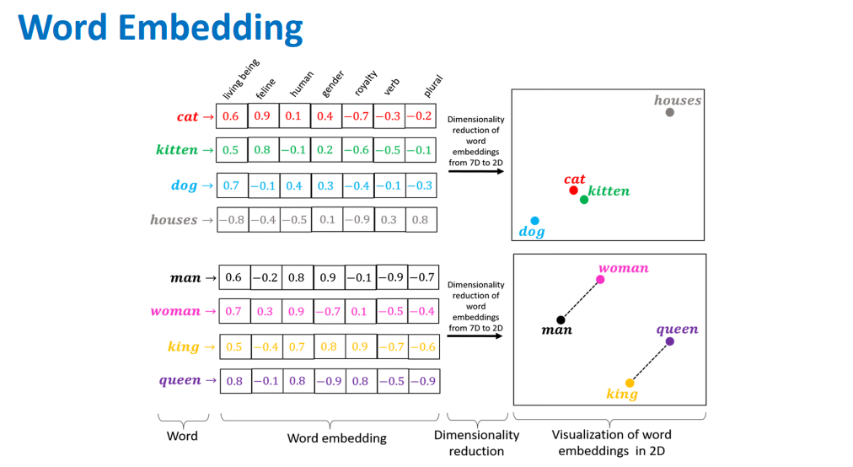
NLP
Notes:
**English Presentation Script:**
---
**Understanding Word Embeddings Through Examples**
**What Do These Vectors Mean?**
The table shows numerical vector representations (embeddings) for words like *cat, dog, man, king*, etc. Each number represents a dimension in a high-dimensional space, capturing semantic and syntactic features.
**Key Observations**:
1. **Similar Words Have Similar Vectors**:
- Compare *cat* (`[0.6, 0.9, ...]`) and *kitten* (`[0.5, 0.8, ...]`). Their vectors are close, reflecting their semantic similarity.
- *Dog* (`[0.7, -0.1, ...]`) shares some features with *cat* (both animals) but differs in others.
2. **Contextual Relationships**:
- *King* (`[0.5, -0.4, ...]`) and *queen* (`[0.8, -0.1, ...]`) differ in gender but share "royalty" features.
- Analogies like *king - man + woman ≈ queen* can be inferred from vector arithmetic.
3. **Divergent Meanings**:
- *Houses* (`[-0.8, -0.4, ...]`) has a distinct vector, reflecting its unrelated context (buildings vs. animals/humans).
**How Are These Embeddings Used?**
- **Semantic Analysis**: Identify synonyms or related terms.
- **Machine Translation**: Map words across languages using shared vector spaces.
- **Classification**: Improve models by feeding meaningful vectors instead of raw text.
**Visualization Tip**:
Use dimensionality reduction (e.g., PCA, t-SNE) to plot these vectors in 2D/3D and observe clusters (e.g., animals, humans).
**Algorithms Behind This**:
Methods like **Word2Vec**, **GloVe**, or **fastText** generate such embeddings by analyzing word co-occurrence patterns.
---
**Türkçe Sunum Metni:**
---
**Kelime Gömmelerini Örneklerle Anlamak**
**Bu Vektörler Ne Anlama Geliyor?**
Tabloda *kedi, köpek, adam, kral* gibi kelimelerin sayısal vektör temsilleri (gömme) gösteriliyor. Her sayı, kelimenin anlamsal ve sözdizimsel özelliklerini yakalayan yüksek boyutlu bir uzaydaki bir boyutu temsil eder.
**Temel Gözlemler**:
1. **Benzer Kelimeler Benzer Vektörlere Sahiptir**:
- *Kedi* (`[0.6, 0.9, ...]`) ve *yavru kedi* (`[0.5, 0.8, ...]`) vektörleri birbirine yakındır, anlamsal benzerliği yansıtır.
- *Köpek* (`[0.7, -0.1, ...]`), *kedi* ile bazı özellikleri paylaşır (hayvan) ancak farklılıklar da içerir.
2. **Bağlamsal İlişkiler**:
- *Kral* (`[0.5, -0.4, ...]`) ve *kraliçe* (`[0.8, -0.1, ...]`), cinsiyet farklılıklarına rağmen "hanedan" özelliklerini paylaşır.
- *Kral - erkek + kadın ≈ kraliçe* gibi ilişkiler vektör işlemleriyle modellenebilir.
3. **Farklı Anlamlar**:
- *Evler* (`[-0.8, -0.4, ...]`), tamamen farklı bir vektöre sahiptir (bina vs. canlılar).
**Bu Gömmeler Nasıl Kullanılır?**
- **Anlamsal Analiz**: Eş anlamlı veya ilişkili kelimeleri belirleme.
- **Makine Çevirisi**: Ortak vektör uzayları kullanarak diller arası kelime eşleme.
- **Sınıflandırma**: Ham metin yerine anlamlı vektörlerle model performansını artırma.
**Görselleştirme İpucu**:
Boyut indirgeme (PCA, t-SNE) ile bu vektörleri 2B/3B olarak çizip kümeleri (hayvanlar, insanlar) gözlemleyin.
**Arka Plandaki Algoritmalar**:
**Word2Vec**, **GloVe** veya **fastText** gibi yöntemler, kelime eşdizim desenlerini analiz ederek bu gömme vektörlerini üretir.
---

Slide 4
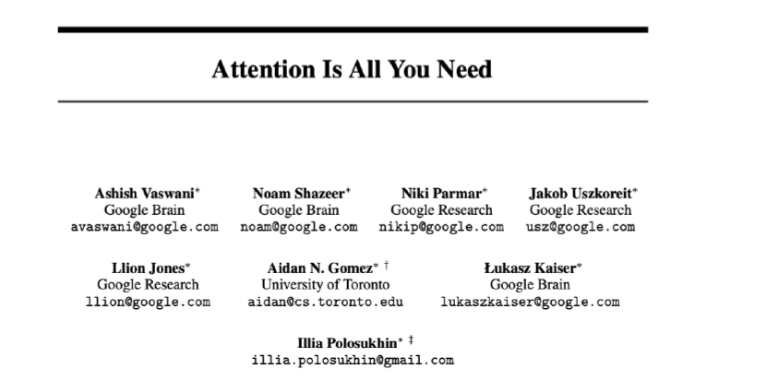
Transformer

Slide 5
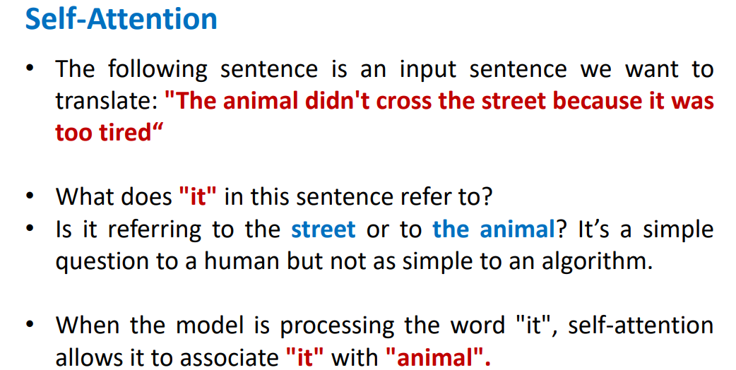
Self-Attention

Slide 6
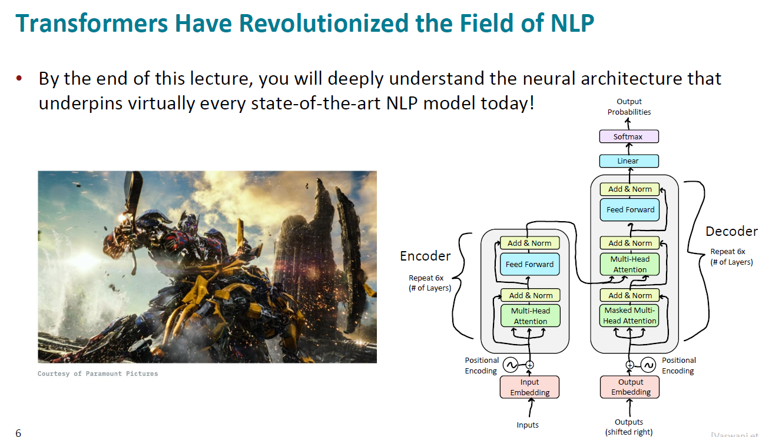

Slide 7
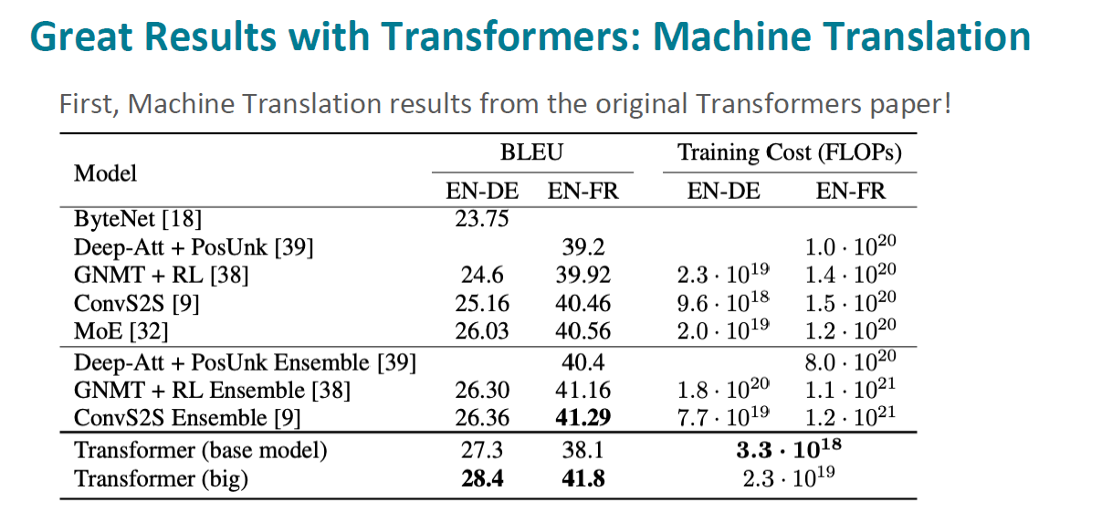

Slide 8
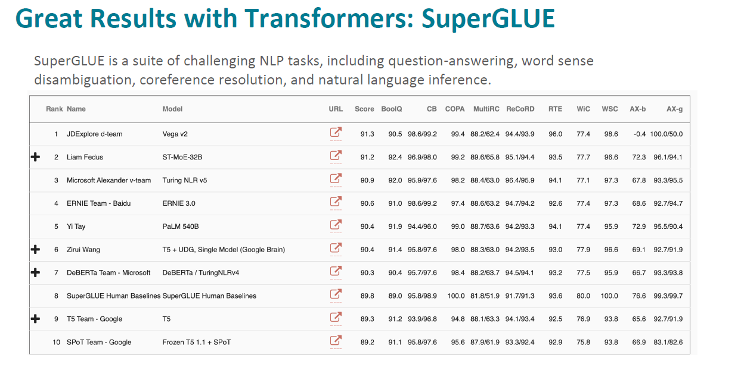

Slide 9
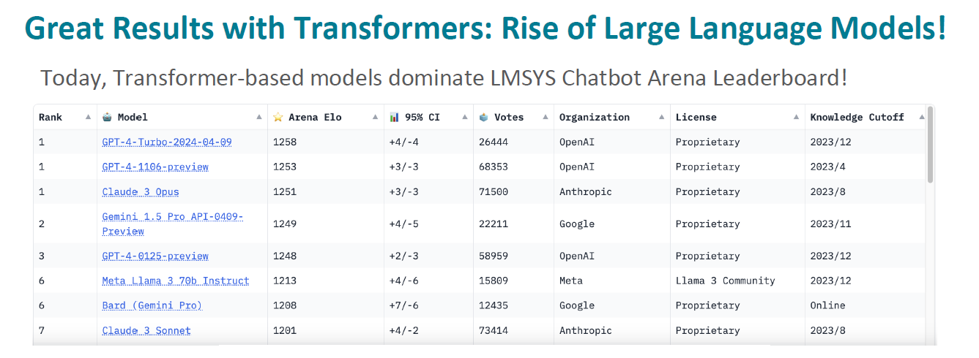

Slide 10
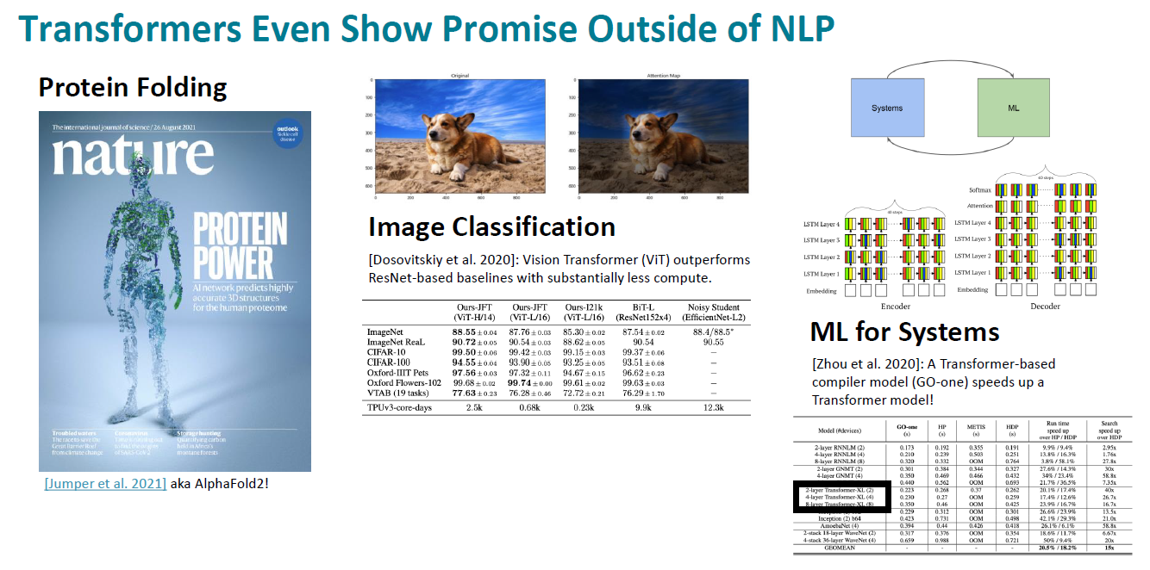

Slide 11
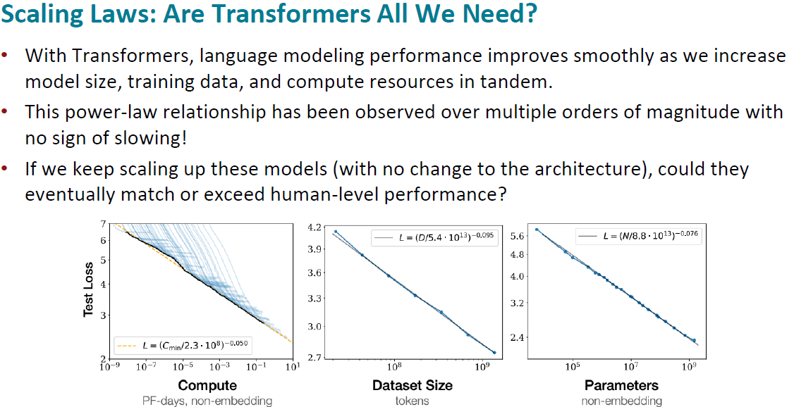

Slide 12
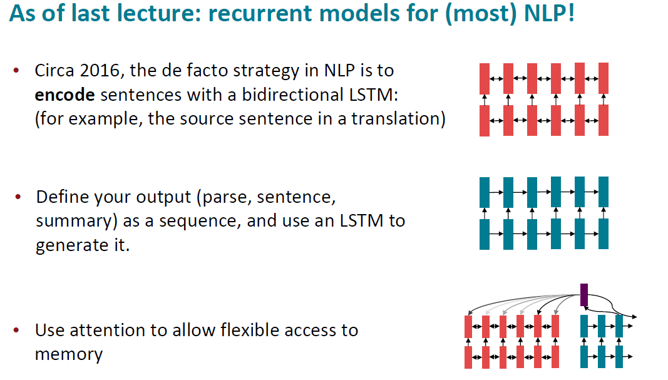

Slide 13
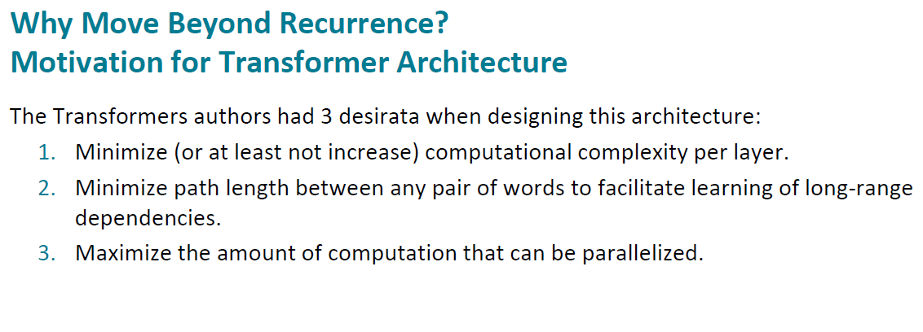

Slide 14
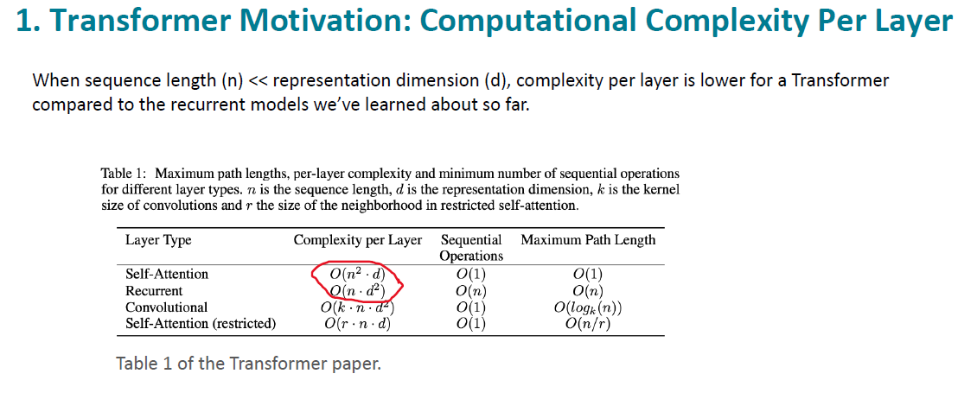

Slide 15
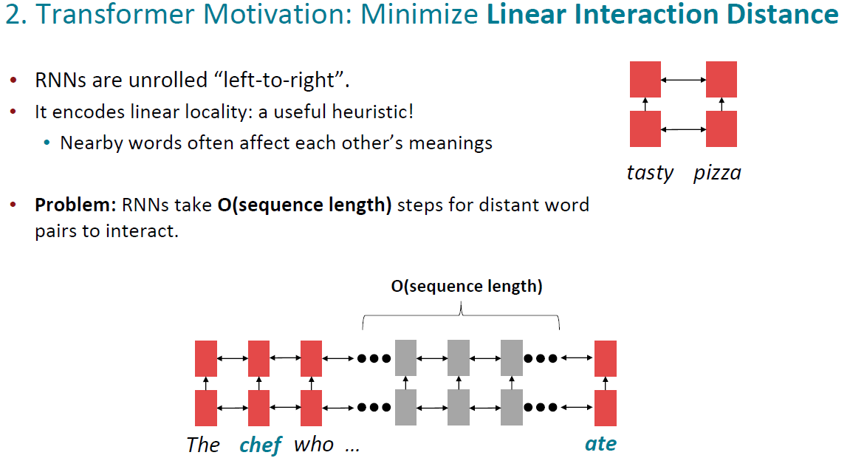

Slide 16
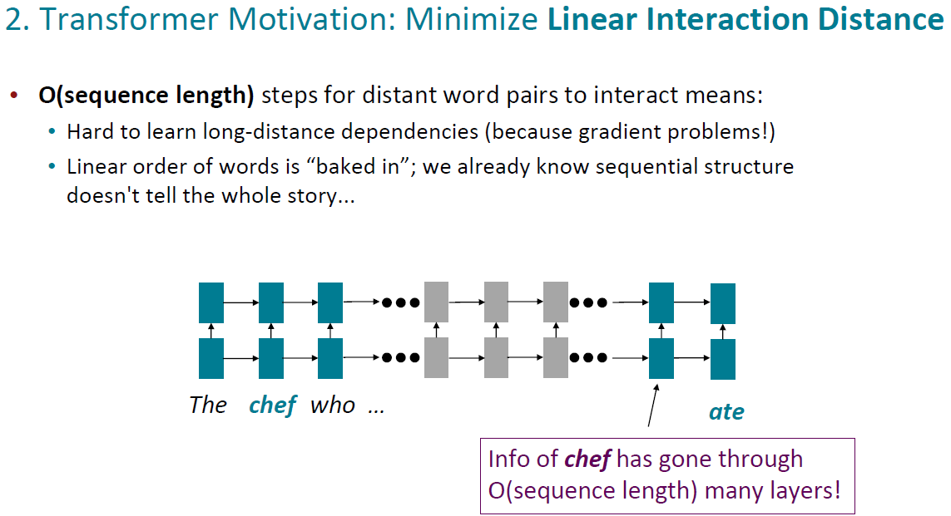

Slide 17
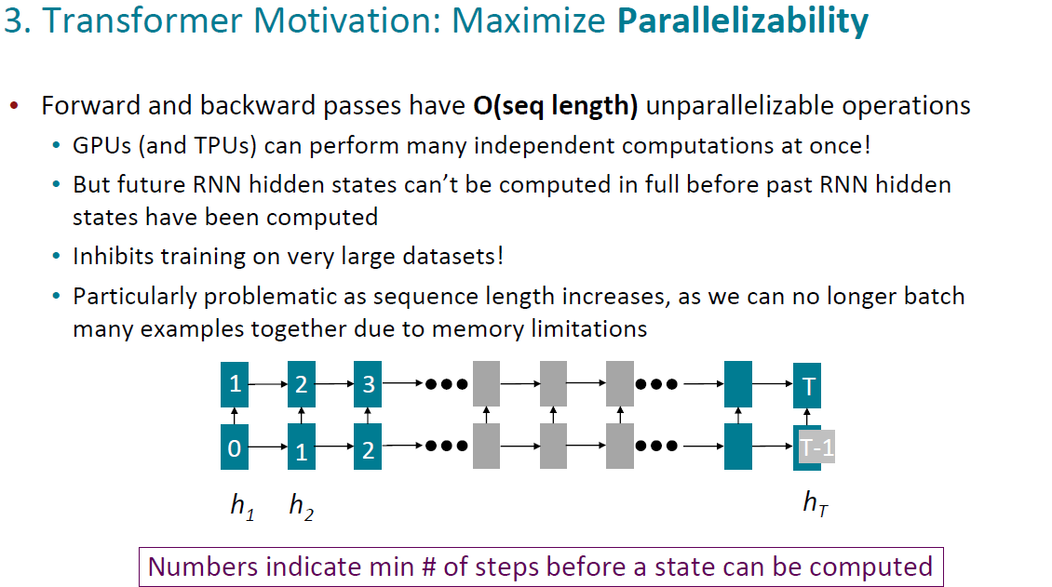

Slide 18
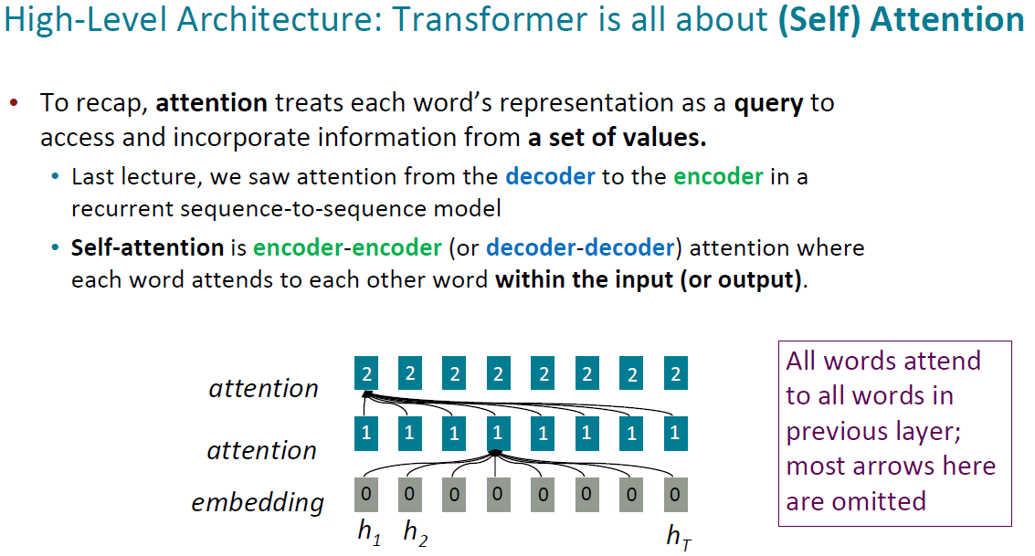

Slide 19
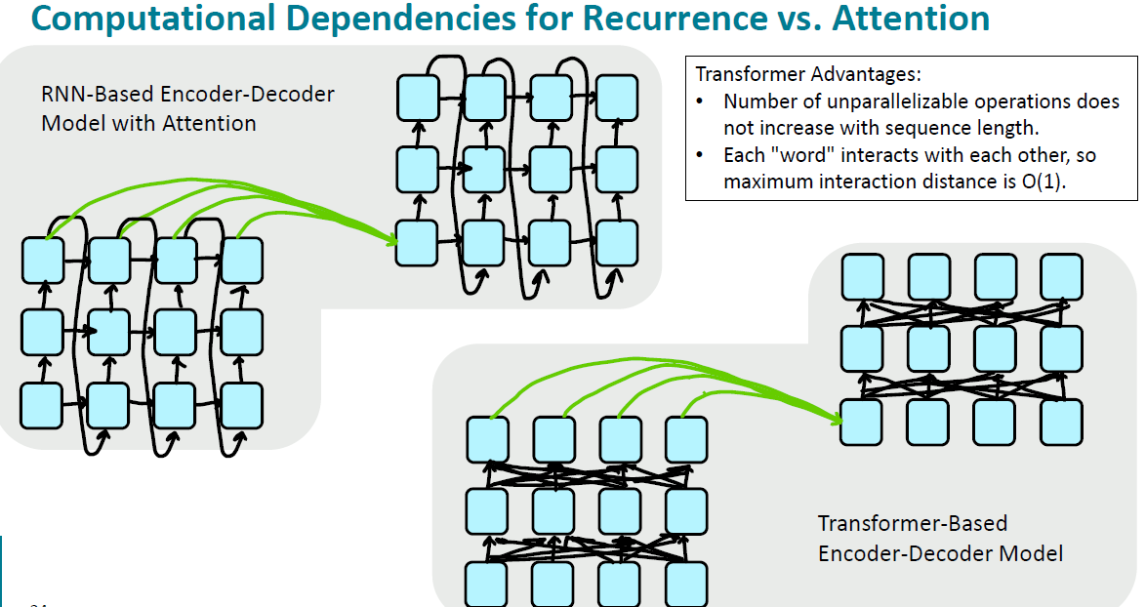

Slide 20
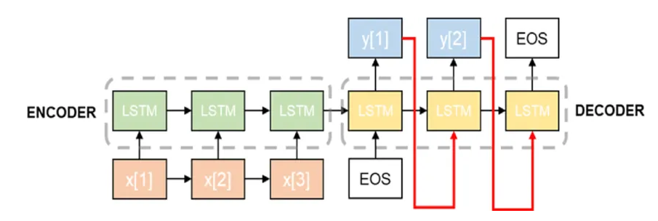
Seq2Seq

Slide 21
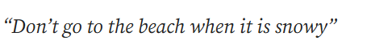
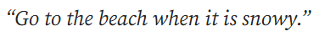
Seq2Seq

Slide 22
Seq2Seq

Slide 23
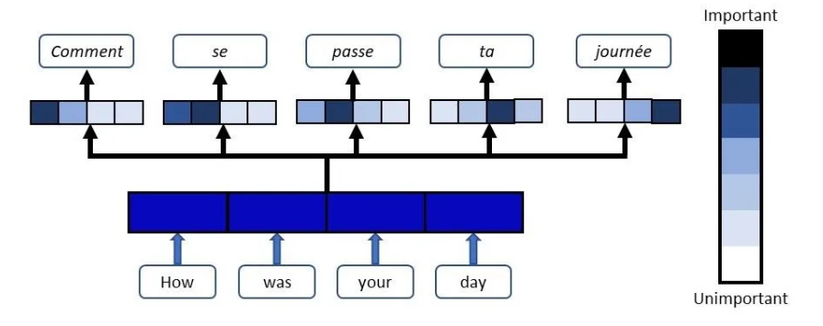
Attention Mechanism
The attention mechanism is a neural network architecture that allows a deep learning model to focus on specific and relevant aspects of the input data.
Notes:
When we look at the example in the image above;
in a model that translates English to French,
after the sentence “How was your day” passes through the model,
it can understand from the attention map of each word that it should produce the sentence “Comment se passe ta journée” in its output.
Attention blocks check the contexts of the words themselves and other words and produce the attention map.
The model can provide a more appropriate output without losing context by looking at the attention map produced.

Slide 24
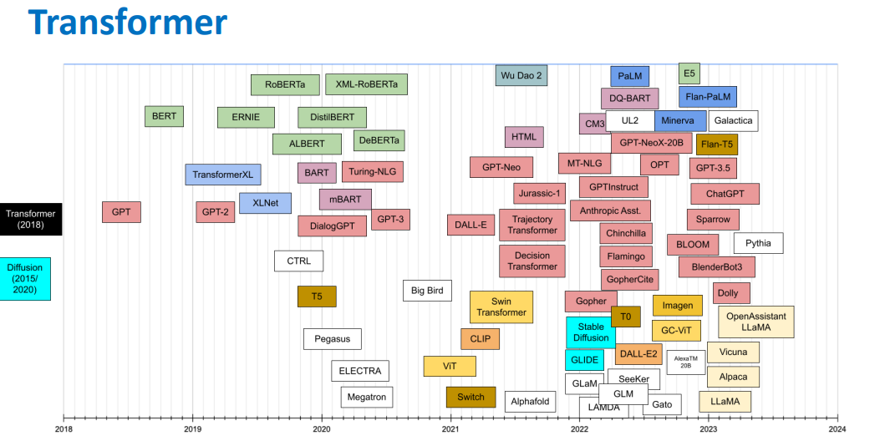
Transformer Architecture
24

Slide 25
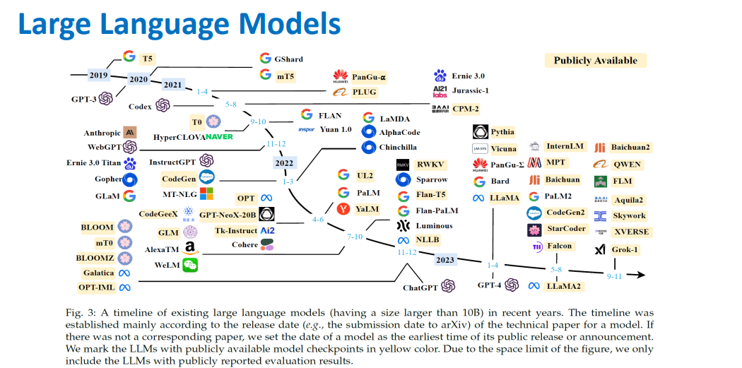
LLM
25

Slide 26
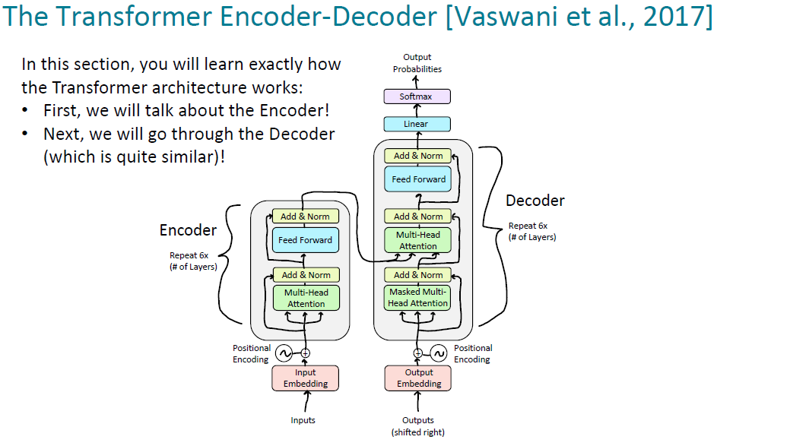

Slide 27

Transformer

Slide 28

Transformer

Slide 29
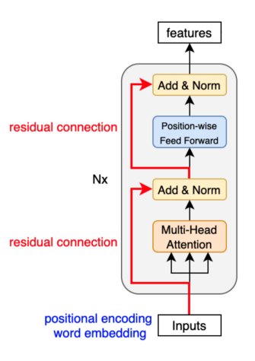
Encoder
The main purpose of the encoder block is to provide the necessary data for the output we want to get by encoding the given input data.
This data includes the words and context in the given sentence.
To perform the encoding, the encoder block uses word embedding, positional encoding, multi-head attention, normalization and a series of linear layers.
Notes:
The main purpose of the encoder block is to provide the necessary data for the output we want to get by encoding the given input data.
This data includes the words and context in the given sentence.
To perform the encoding, the encoder block uses word embedding, positional encoding, multi-head attention, normalization and a series of linear layers.
Let's talk about the stages of word embedding, positional encoding and multi-head attention.

Slide 30
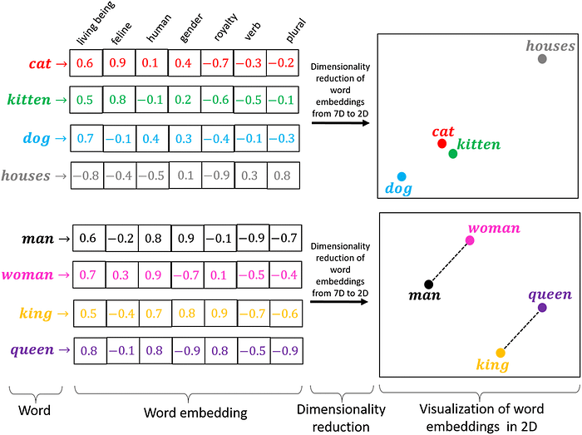
Word Embedding

Slide 31
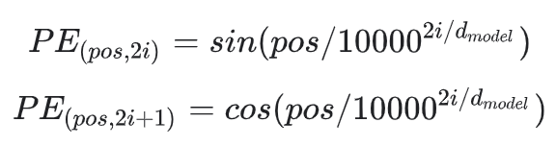
Positional Encoding
Positional Encoding enables the conversion of word vectors resulting from the word embedding layer of text data into numerical vectors that contain the order information of the words.

Slide 32
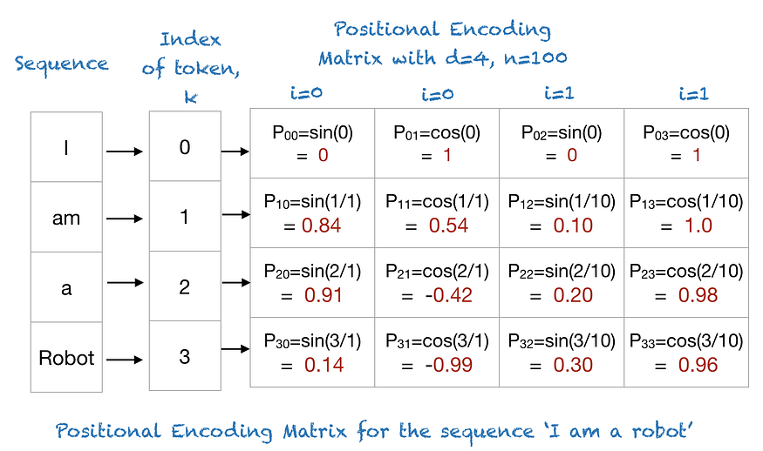
Positional Encoding
Data passing through the positional encoding layer becomes ready to be processed in the encoder section of the transformer model.

Slide 33
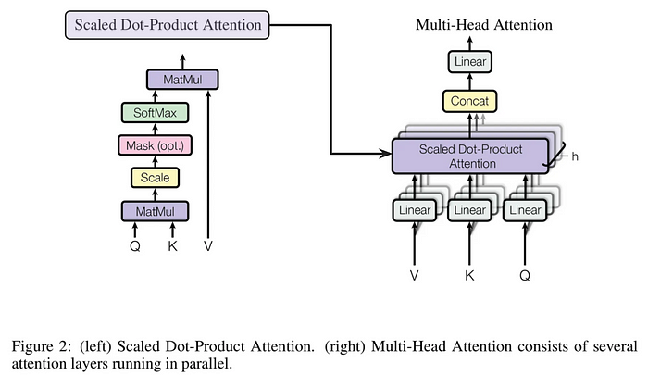
Multi-Head Attention

Slide 34

Multi-Head Attention
The first step in calculating self-attention is to create three vectors from each of the encoder’s input vectors (in this case, the embedding of each word).
So for each word, we create a Query vector, a Key vector, and a Value vector. These vectors are created by multiplying the embedding by three matrices that we trained during the training process.

Slide 35
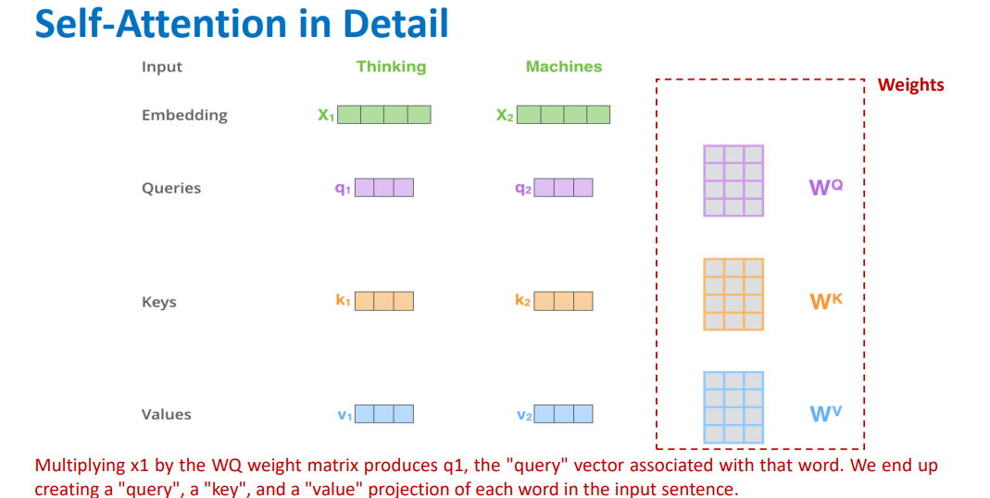
Self-Attention

Slide 36
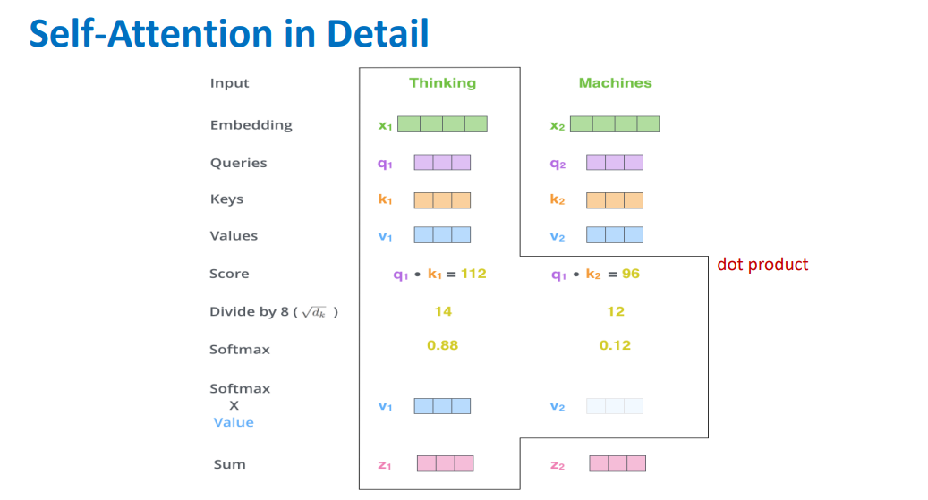
Self-Attention

Slide 37
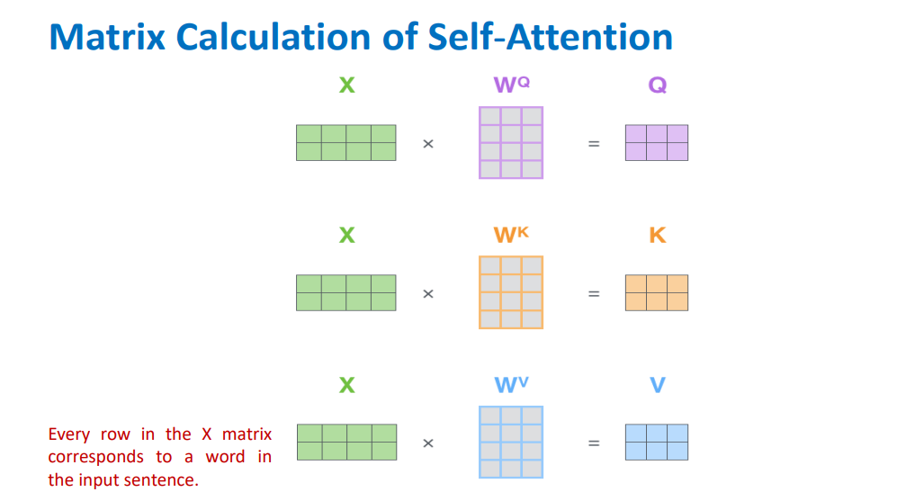
Self-Attention

Slide 38
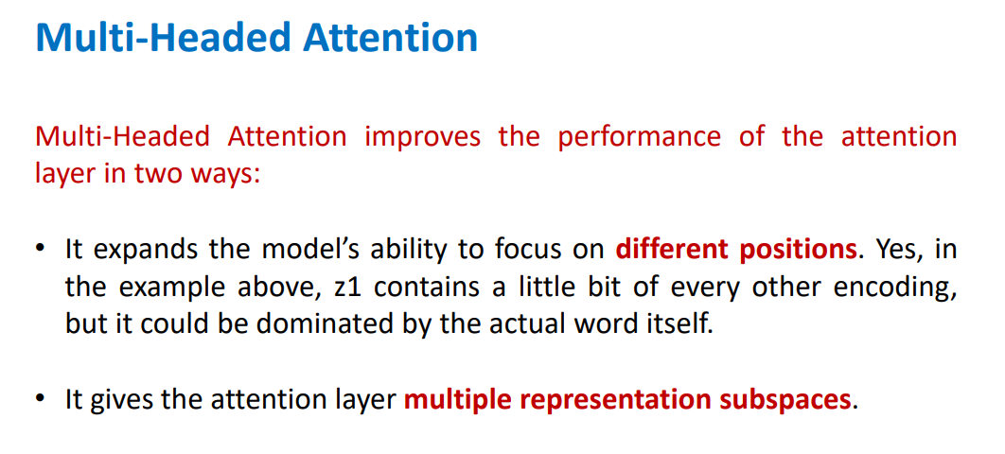
Multi-Headed Attention

Slide 39
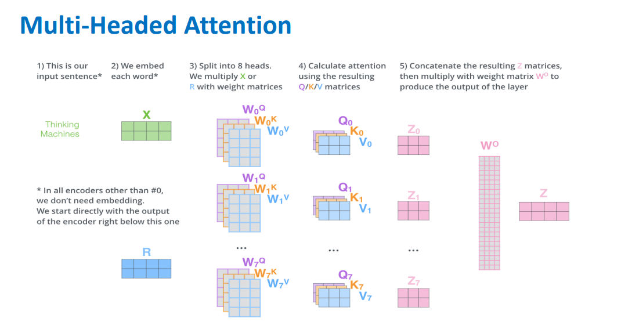
Multi-Headed Attention

Slide 40
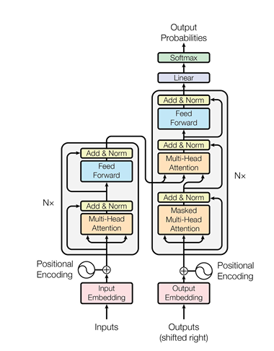
Transformer Architecture
40

Slide 41
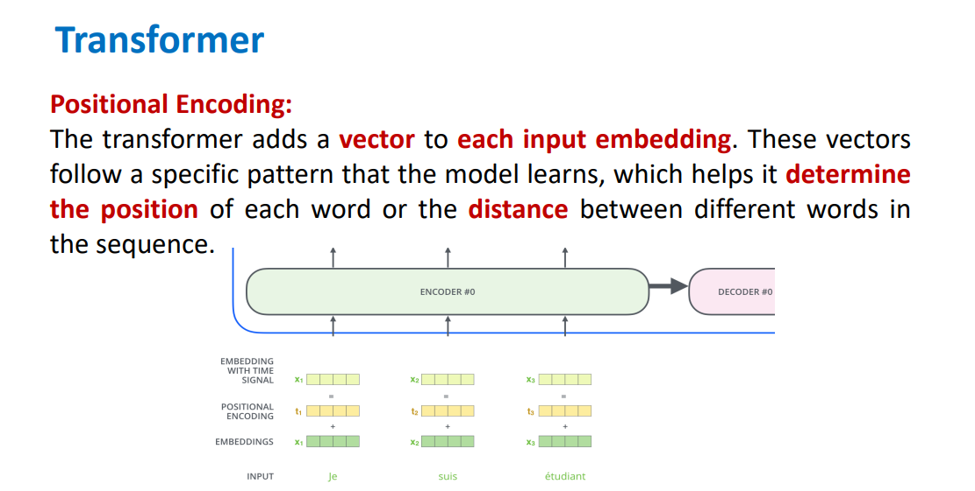
Transformer Architecture
41

Slide 42
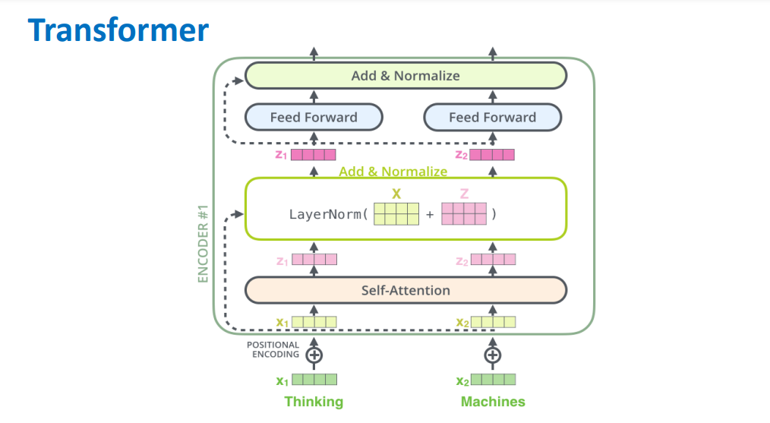
Transformer Architecture
42

Slide 43
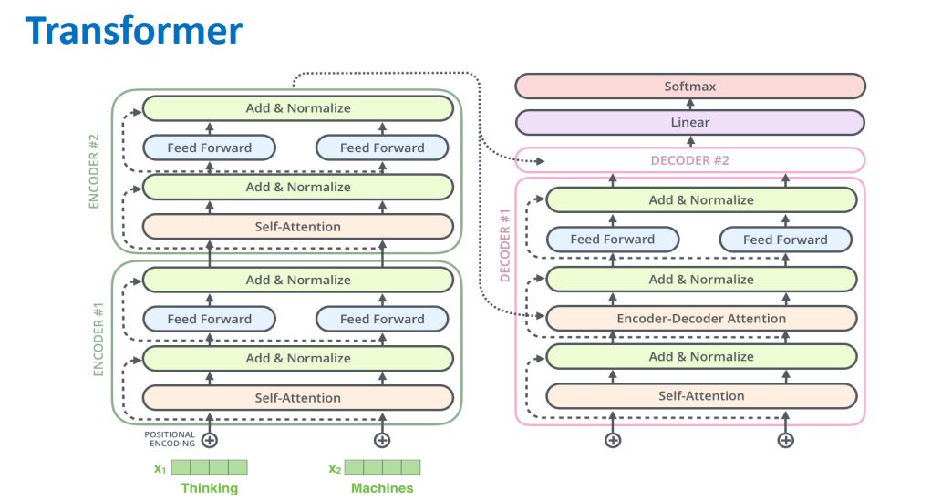
Transformer Architecture
43

Slide 44
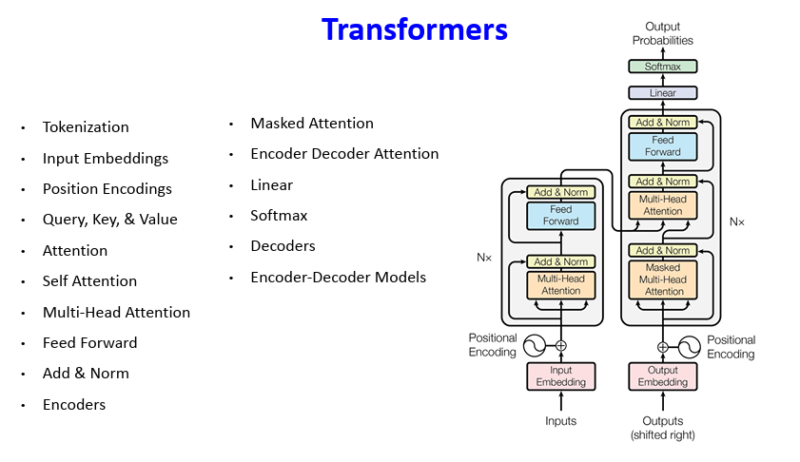
Transformer Architecture
44

Slide 45
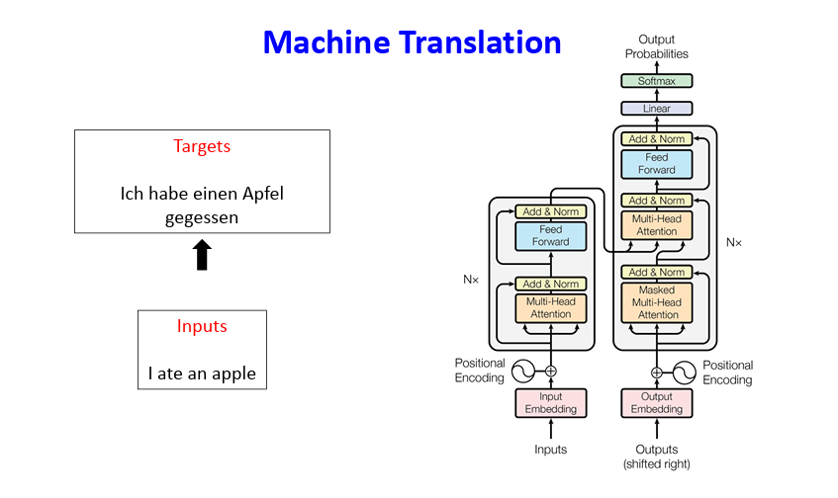
Transformer Architecture
45

Slide 46
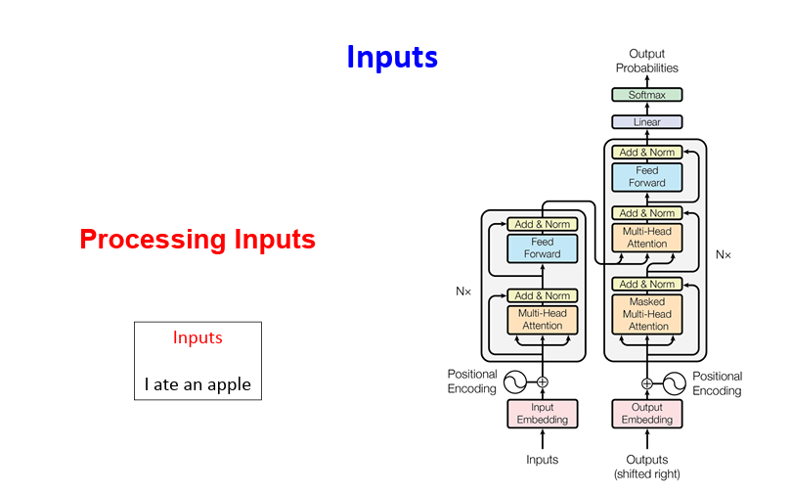
Transformer Architecture
46

Slide 47
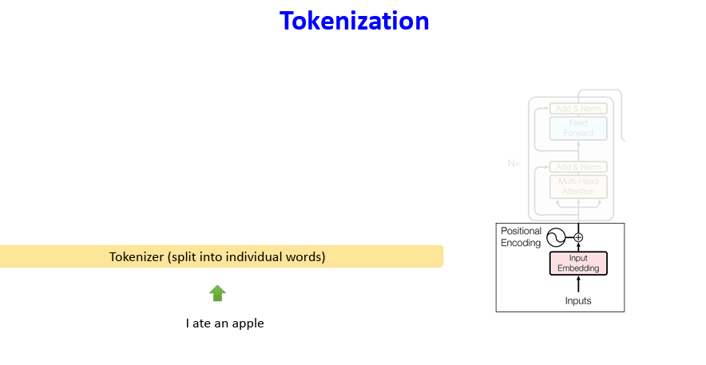
Transformer Architecture
47

Slide 48
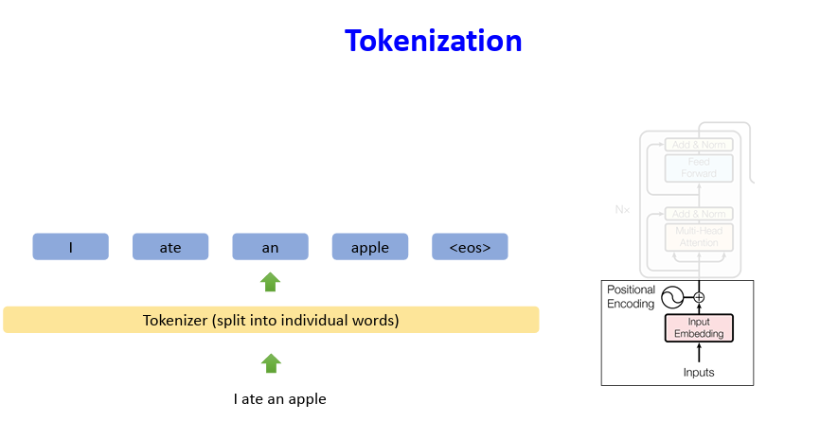
Transformer Architecture
48

Slide 49
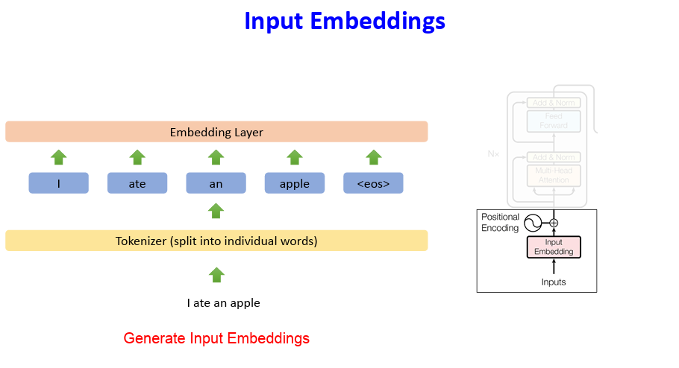
Transformer Architecture
49

Slide 50
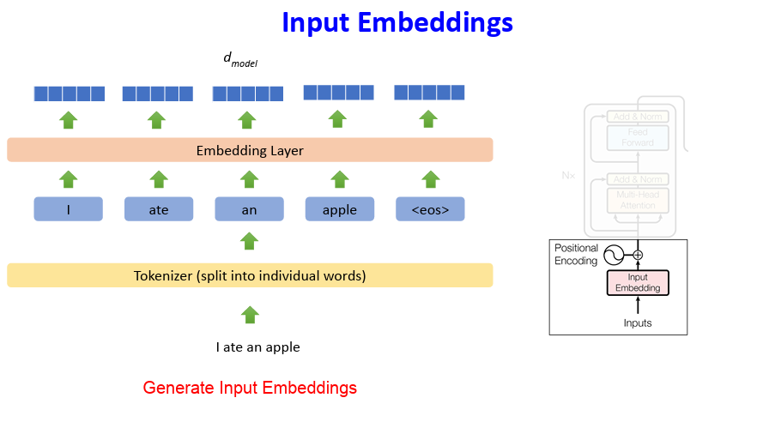
Transformer Architecture
50

Slide 51
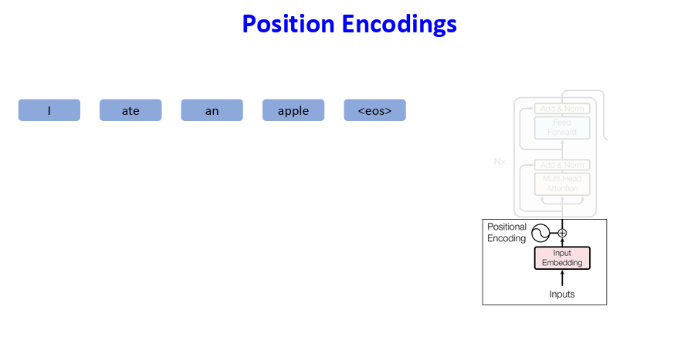
Transformer Architecture
51

Slide 52
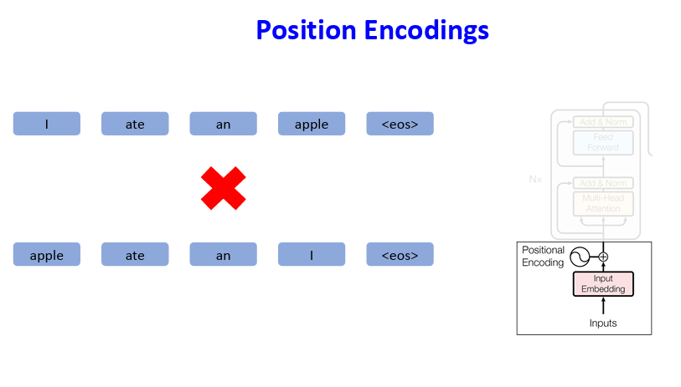
Transformer Architecture
52

Slide 53
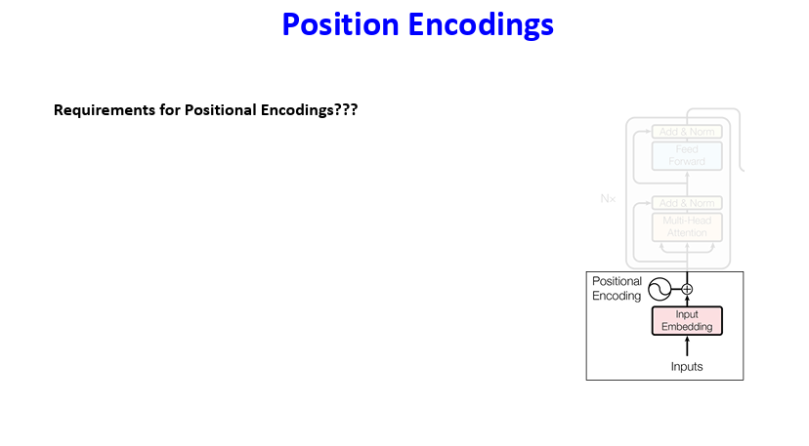
Transformer Architecture
53

Slide 54
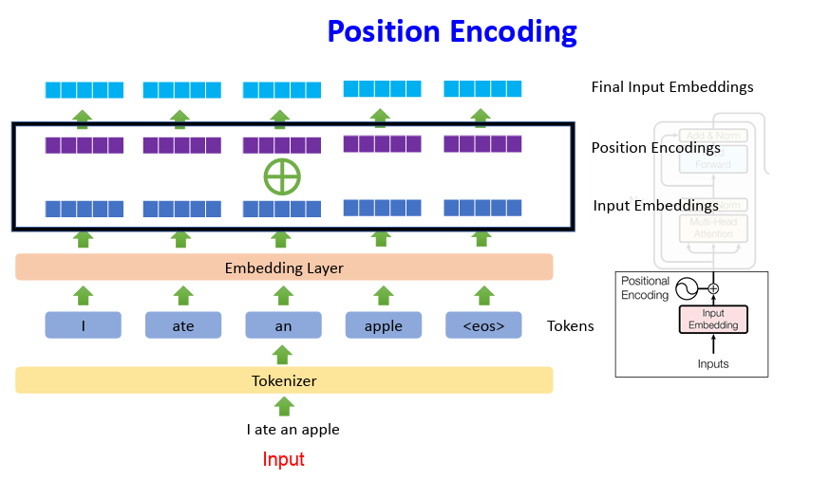
Transformer Architecture
54

Slide 55

Transformer Architecture
55

Slide 56

Transformer Architecture
56

Slide 57

Transformer Architecture
57

Slide 58

Transformer Architecture
58

Slide 59

Transformer Architecture
59

Slide 60


Transformer Architecture
60

Slide 61


Transformer Architecture
61

Slide 62

Transformer Architecture
62

Slide 63

Transformer Architecture
63

Slide 64

Transformer Architecture
64

Slide 65

Transformer Architecture
65

Slide 66

Attention
66

Slide 67

Attention
67

Slide 68

Attention
68

Slide 69

Attention
69

Slide 70

Attention
70

Slide 71

Attention
71

Slide 72

Attention
72

Slide 73

Attention
73

Slide 74

Attention
74

Slide 75

Attention
75

Slide 76

Self-Attention
76

Slide 77

Self-Attention
77

Slide 78

Self-Attention
78

Slide 79

Self-Attention
79

Slide 80

Self-Attention
80

Slide 81

Self-Attention
81

Slide 82

Self-Attention
82

Slide 83

Self-Attention
83

Slide 84

Self-Attention
84

Slide 85

Self-Attention
85

Slide 86

Self-Attention
86

Slide 87

87

Slide 88

88

Slide 89

89

Slide 90

90

Slide 91

91

Slide 92

92

Slide 93

93

Slide 94

94

Slide 95

95

Slide 96

96

Slide 97

97

Slide 98

98

Slide 99

99

Slide 100

100

Slide 101

101

Slide 102

102

Slide 103

103

Slide 104

104

Slide 105

105

Slide 106

106

Slide 107

107

Slide 108

108

Slide 109

109

Slide 110

110

Slide 111

111

Slide 112

112

Slide 113

113

Slide 114

114

Slide 115

115

Slide 116

116

Slide 117

117

Slide 118

118

Slide 119

119

Slide 120

120

Slide 121

121

Slide 122

122

Slide 123

123

Slide 124

124

Slide 125

125

Slide 126

126

Slide 127

127

Slide 128

128

Slide 129

129

Slide 130

130

Slide 131

131

Slide 132

132

